Slide 1
Music as therapy or weapon
Presented by: Colm, Darragh & Aaron

Slide 2
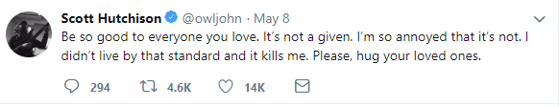

Depression in music

Slide 3
Depression in music
A comprehensive study by Help Musicians UK in November of 2016 found that members of the music community were three times more likely to experience depression than the general public.
From this pilot survey that garnered 2,211 responses, it emerged that 71.1% of respondents identified as having suffered from panic attacks and/ or anxiety, and 68.5% from depression

Slide 4
Depression in music
What is Music Therapy?
Music Therapy is the clinical and evidence-based use of music interventions to accomplish individualized goals within a therapeutic relationship by a credentialed professional who has completed an approved music therapy program.
Music therapy interventions can be designed to:
Promote Wellness
Manage Stress
Alleviate Pain
Express Feelings
Enhance Memory
Improve Communication
Promote Physical Rehabilitation

Slide 5
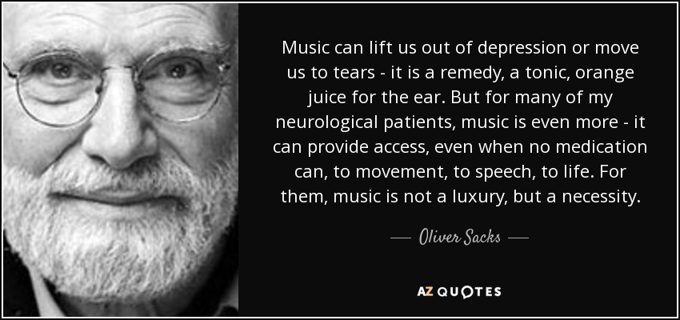
Depression in music

Slide 6
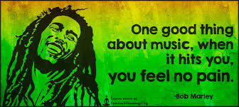
Depression in music

Slide 7
Therapeutic benefits of music
BenefIts include:
Help express Emotion(Autism)
Alleviates stress
Reduces Symptoms of Depression
Help Boost Mood

Slide 8
Alleviating stress
Tempo plays a big part
Slower Tempo = reduced Heart Rate
60 beats per minute = causes brain to synchronize with beat
Faster Tempo = Increased Stress?
Faster tempo will increase heart rate but not increase stress

Slide 9
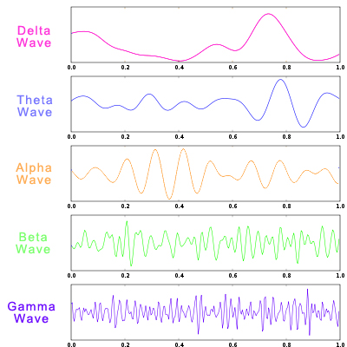
Sound waves
4 Different types – each invoke a specific state in brain
Beta Waves – “normal”
Alpha Waves – relaxed
Theta Waves – Meditation
Delta Waves – Deep sleep (REM)

Slide 10
Pain management
Music increases Oxytocin
Effects seen during open heart surgery and with cancer patients
Two Brain Mechanisms:
Music can release opioids in the brain which produce effects that ease pain
Music directs attention away from pain

Slide 11
Example : autism
Music Triggers both hemispheres of Brain
Therefore, supports cognitive activity
Autistic children – Difficulty communicating
University of Wisconsin in 2006
20 autistic patients listened to music in numerous 20 minute sessions
Different behaviour shown after sessions
Classical Music – steady, uniform, predictable beat

Slide 12
Sound and the physical body
Sound can also affect the physical body.
Can cause pain and discomfort
Instinctive fear of loud sounds

Slide 13
Amplitude
Loud noises hurts the ears
Pain threshold – 150dB (aircraft take-off at close distance)
Prolonged exposure causes loss of hearing

Slide 14
Frequency
Causes the cells to heat up by vibration
Cavitation due to compression and rarefaction

Slide 15
Audio Weapons
Mega Speakers
Used widely: Seabourn Spirit & Ferguson Unrest
Frequency-related weapons
Sonic Nausea and “The Mosquito”

